Slide 1


September 6, 2017: Channel Partners
Connection Call

Slide 2
AGENDA
Overview
  Vision
  Problems We Solve
  Products and Services
Upcoming release: MDNA App!
Channel Partner Program
  Overview and Vision
  Using MDNA to Build Your Brand
Q&A
Future Calls and Closing

Slide 3
My story

Slide 4
Vision
Change the work experience for employees.
  Employees: How they engage with their work.
  Employers: How to create an experience such that employees motivate themselves.

Slide 5
Vision
Organizational culture, engagement, and employee brand proposition remain top priorities in 2017; employee experience ranks as a major trend again this year.*
*February 28, 2017, The employee experience: Culture, engagement, and beyond - 2017 Global Human Capital Trends, https://dupress.deloitte.com/dup-us-en/focus/human-capital-trends/2017/improving-the-employee-experience-culture-engagement

Slide 6
OVERVIEW
A software tool that measures culture and employee engagement.
Foundation for brand culture work.
  Build your culture. Build your brand.
Result:
  Change the employee experience and how they engage and view their work.
  Culture and Individual Transformation.

Slide 7
Problems we solve
Very little (or no) employee engagement.
  Only 32% of US employees are engaged.*
  Nearly nine in ten executives (85%) rated engagement as an important (38%) or very important (48%) priority for their companies.*
  * 50 HR and Recruiting Statistics for 2017, http://resources.glassdoor.com/rs/899-LOT-464/images/50hr-recruiting-and-statistics-2017.pdf

Slide 8
Problems we solve
Very little (or no) ROI on brand/marketing efforts.
  Companies with a formal engagement strategy in place are 67% more likely to improve their revenue per full-time equivalent on a year-over-year basis.*
  Boosting employee satisfaction by one Glassdoor rating point raises the market value of a company by 7.9%.*
  * 50 HR and Recruiting Statistics for 2017, http://resources.glassdoor.com/rs/899-LOT-464/images/50hr-recruiting-and-statistics-2017.pdf

Slide 9
Problems we solve
Companies don’t know where to start.
  Fifty-nine (59%) percent of survey respondents reported they were not ready or only somewhat ready to address the employee experience challenge.*
*February 28, 2017, The employee experience: Culture, engagement, and beyond - 2017 Global Human Capital Trends, https://dupress.deloitte.com/dup-us-en/focus/human-capital-trends/2017/improving-the-employee-experience-culture-engagement

Slide 10
PRODUCTS AND SERVICES
Assessments
  Basic and Premium Assessment
  Measure Six Dimensions of Culture and
  Four Dimensions of Employee Engagement
Certification
  101, 201, 301, 401
  101 Culture Champion to 401 Brand Culture Strategist
App (September 2017 release)
  Brand Culture Focus

Slide 11
The MDNA App
Many organizations get stuck in understanding how to engage their employees to build their brand and achieve business results.
Build your culture. Build your brand.
http://mdna.cloud/app-overview

Slide 12
Channel Partner Program
Overview and Vision
  A Tool to Differentiate Your Business
  3 Ways to Get Involved
    Referral, Contract, Certification
  Connection and Community
Using MDNA to Build Your Brand

Slide 13
Q&A

Slide 14
next call
October 4, 2017: 9am CDT

Slide 15
Thank you!

Slide 16
Features
What We Measure and How

Slide 17
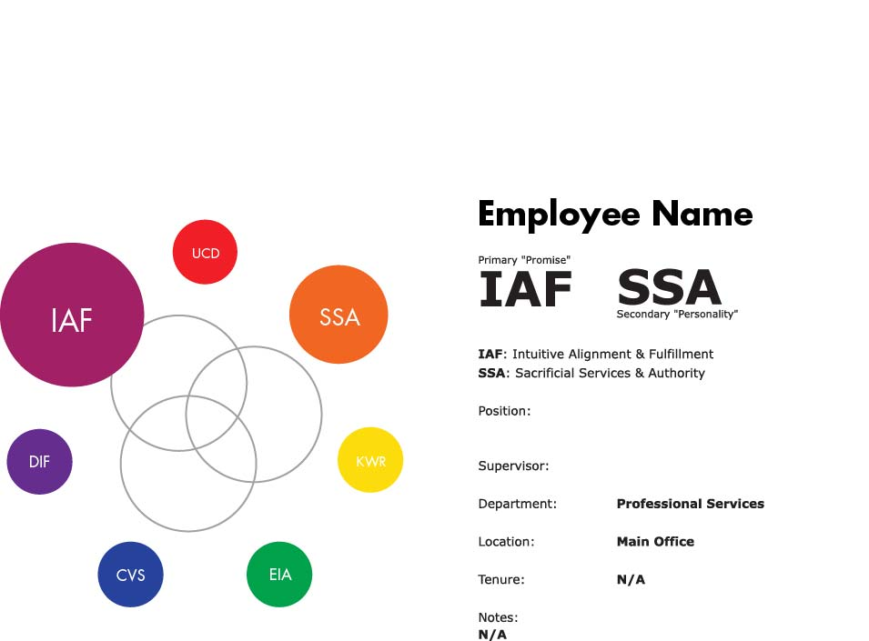
INDIVIDUAL GIFTS

Slide 18
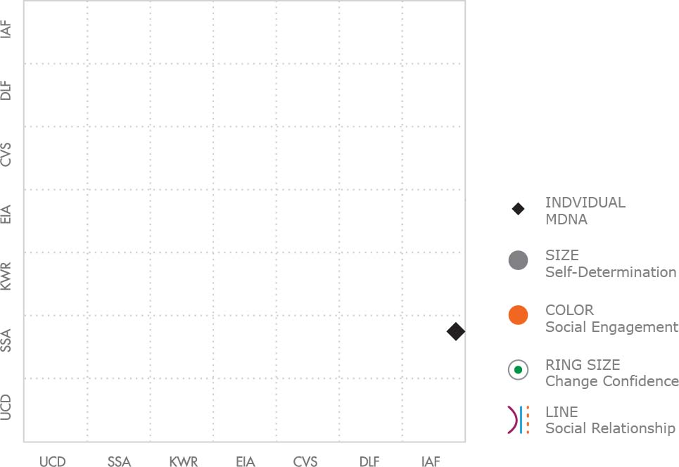
Employee IAF/SSA

Slide 19
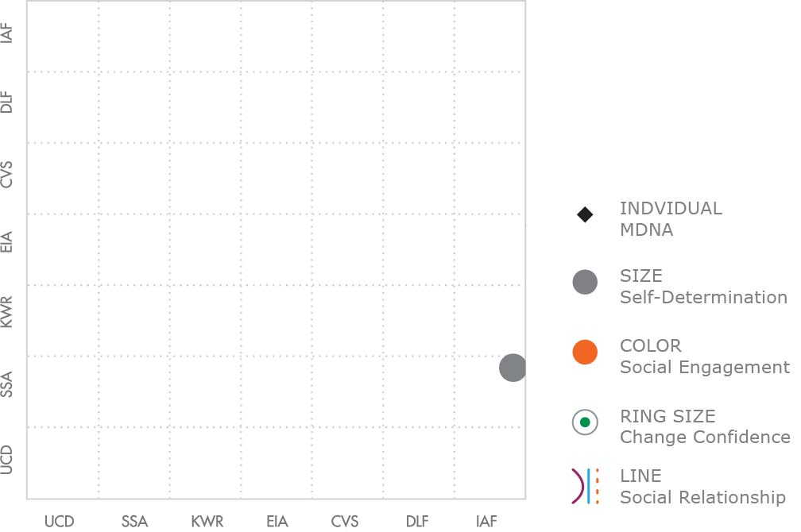
SELF DETERMINATION

Slide 20
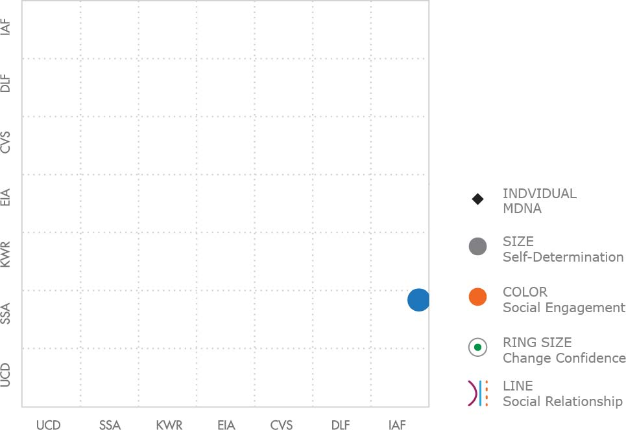
SOCIAL ENGAGEMENT

Slide 21
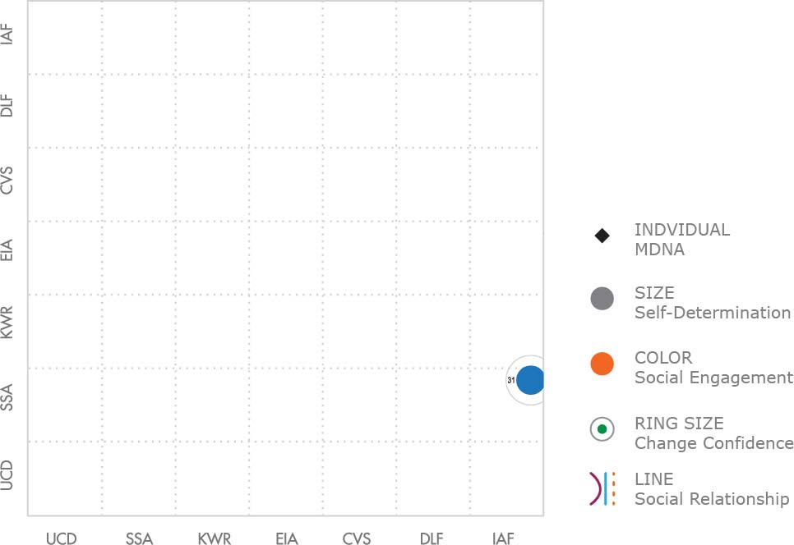
CHANGE & CONFIDENCE

Slide 22
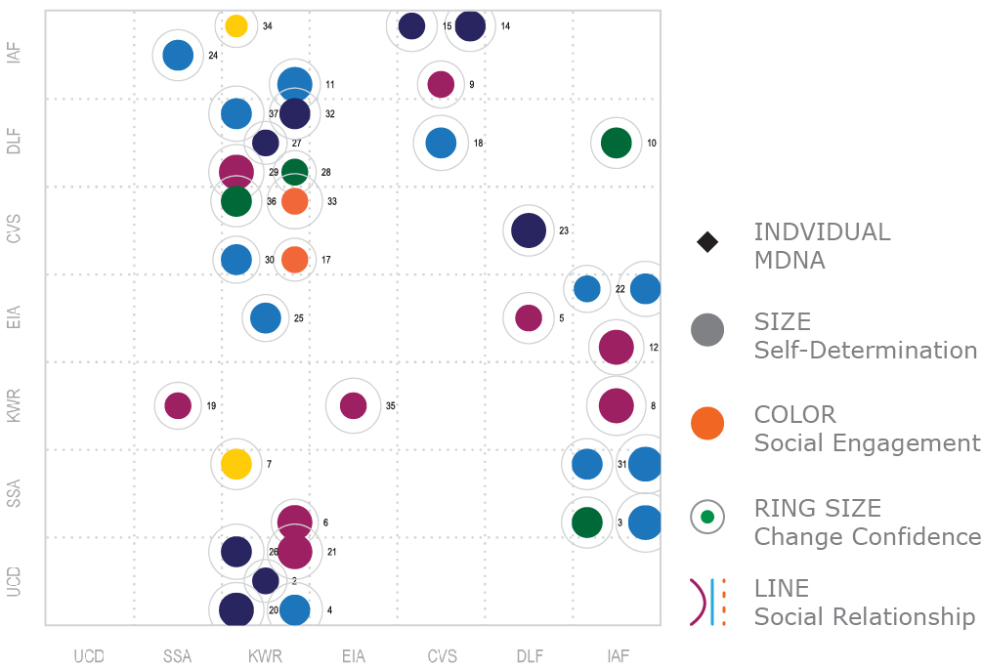
ALL EMPLOYEES

Slide 23
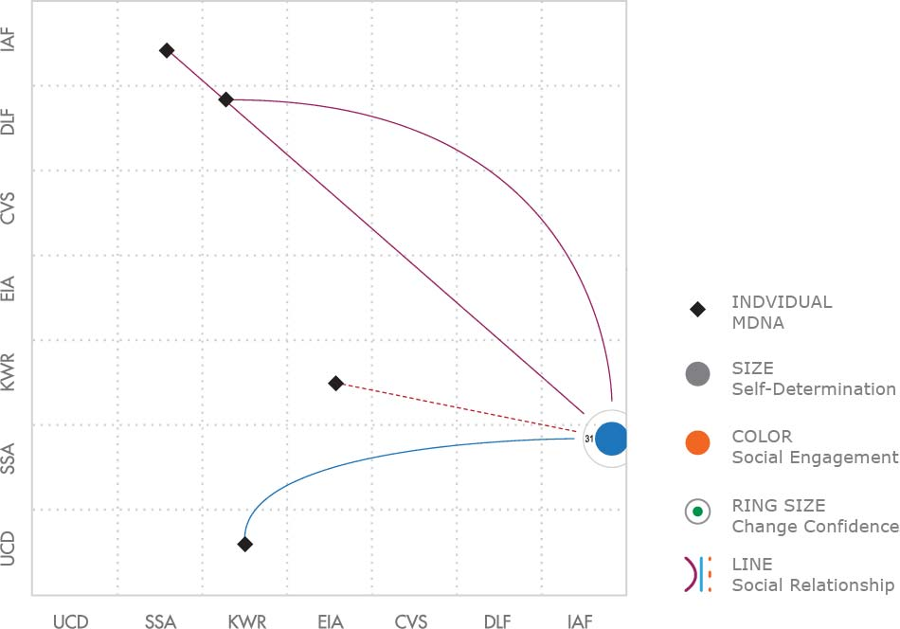
RELATIONSHIPS

Slide 24
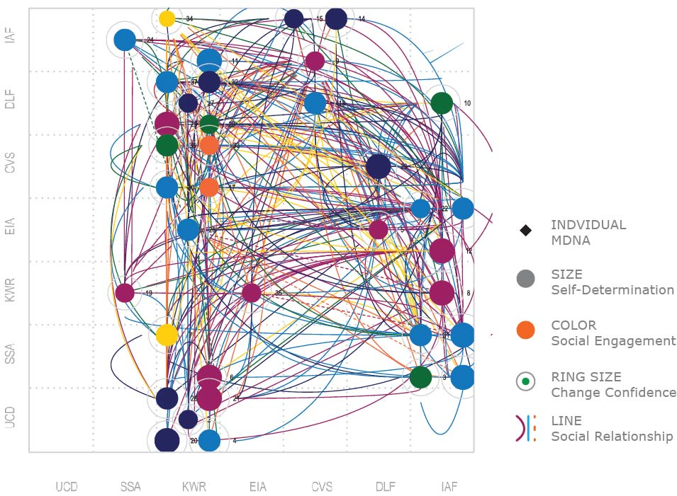
ALL EMPLOYEES AND RELATIONSHIPS

Slide 25
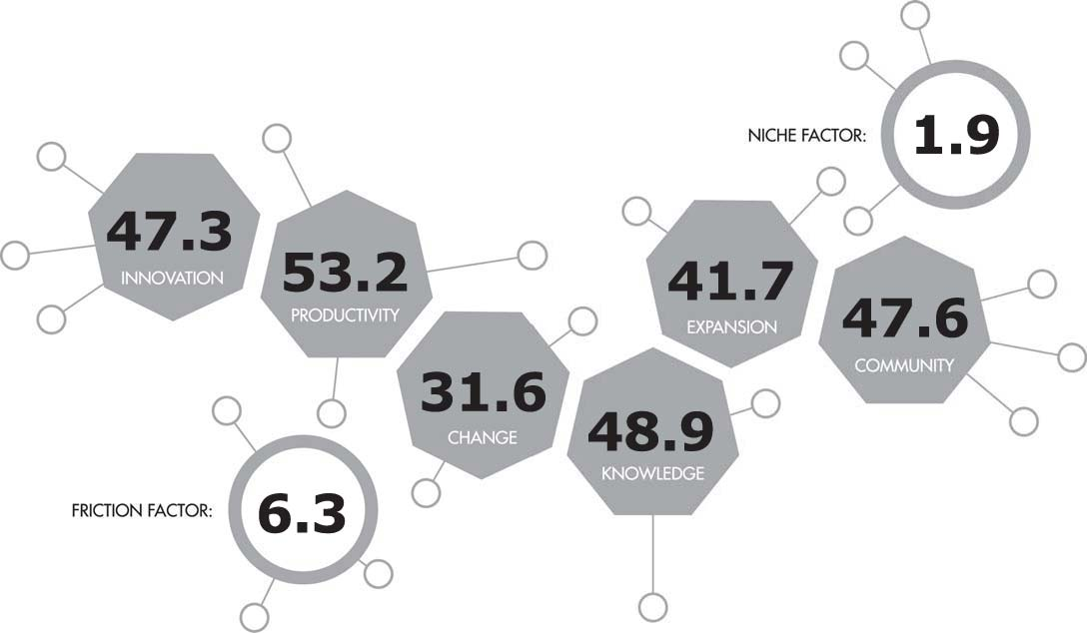
SIX DIMENSIONS OF CULTURE

Slide 26
The MDNA Community
Channel Partners and Certification

Slide 27
Channel partners
Referral
Contract
White Label Certification

Slide 28
certification
MDNA 101 Culture Champion
MDNA 201 Virtual Culture Officer
MDNA 301 MDNA White Label
MDNA 401 Brand Culture Strategist

Slide 29
THANK YOU

